Slide 1
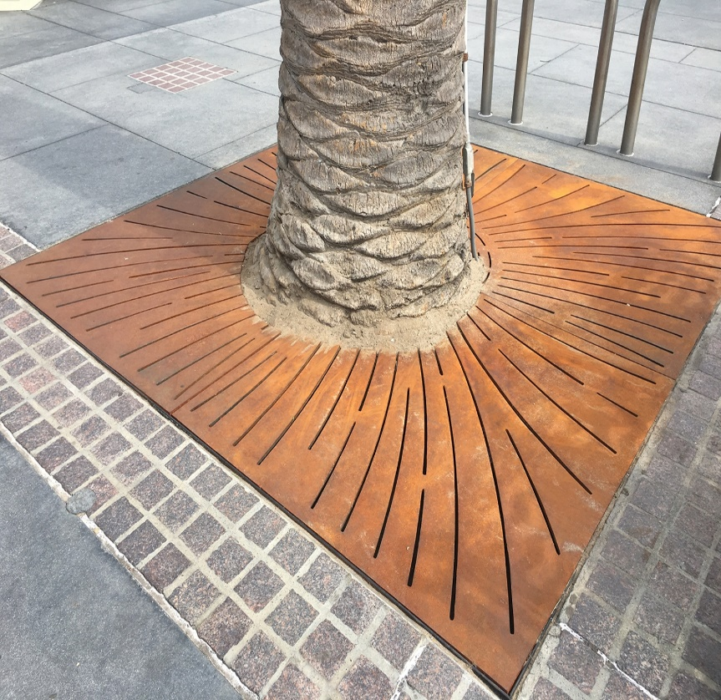
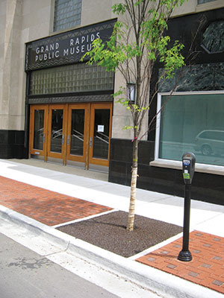
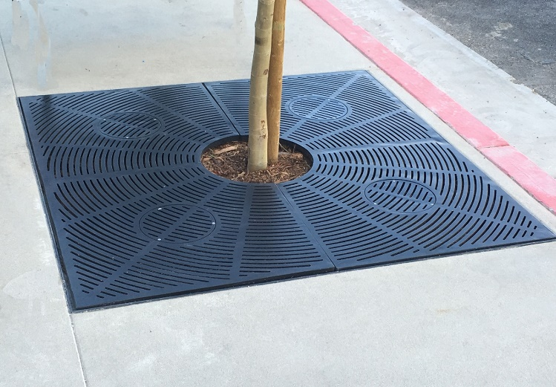
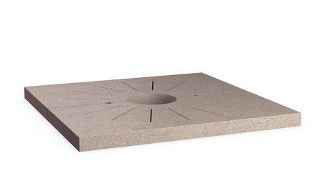
Tree Well Grates
93 tree wells Central Business district
$550 - $900 each depending on style/materials
Can identify smaller # to start
Benefits:
Minimizes annual weeding budget requirements
Increases safety, ADA compliant

